Slide 1
Bootcamp Session (Technical Week-1)
Smriti Ravindran
IDA

Slide 2
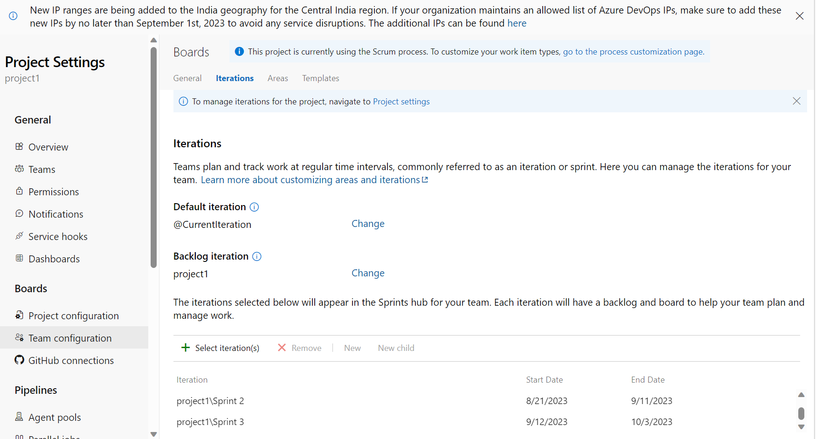
business Analysis and agile
- Brief introduction on Business Analysis
- Insights on Requirement Analysis
- Understood Project Management
- Revised Waterfall Model
- Brushed basics of Agile Method
- Learnt about Sprint
- Obtained information on Scrum and
it’s purpose.

Slide 3
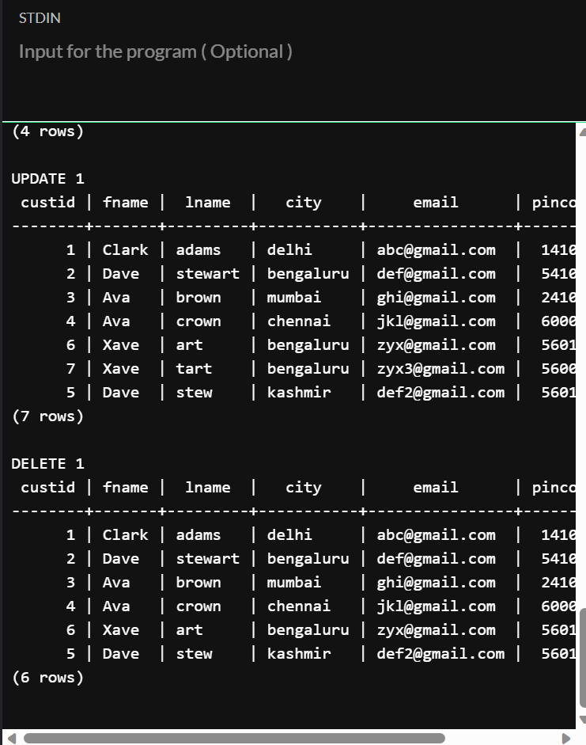
Database and Management Systems
Brushed up basic concepts in PostgreSQL (Hands on Experience)
Creating Table, Inserting rows , used SELECT, FROM and WHERE clauses.
Updation of entities, used operators like between, in , and , or and joins.

Slide 4
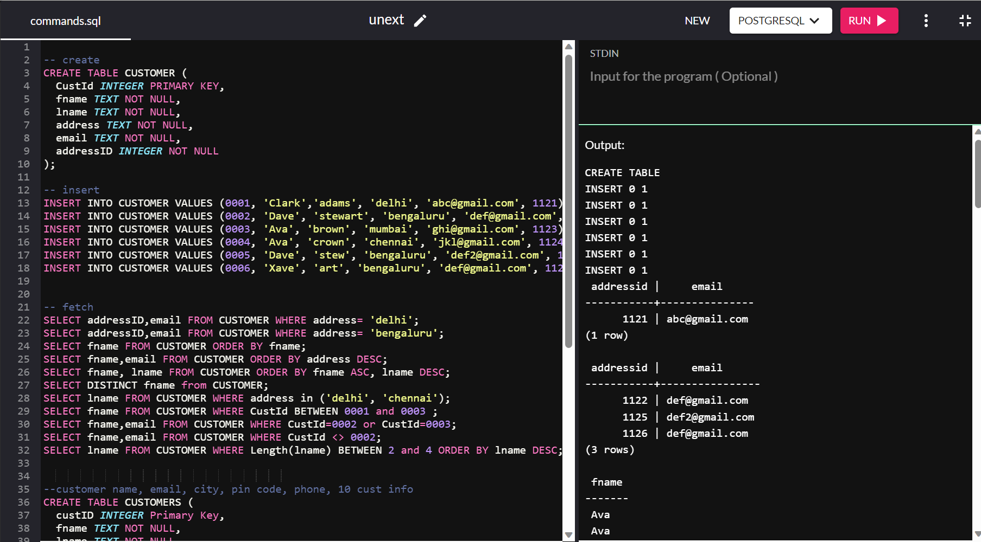

Slide 5
Software Testing
Understood how important Testing is for any product and the difference between bugs, defects and errors.
Learnt Software Development life cycle and Software testing life cycle with their stages that run in a loop.
Obtained insights on Unit testing and integration testing and the need to perform both.
Acquired knowledge on following classes: @BeforeAll, @BeforeEach, @AfterEach, @Order
Observed Softwares (For writing test cases) : Junit, Fitnesse .

Slide 6
Devops (Development + operations)
This domain has the Development team that caters to the planning, designing, coding and testing of a product and the IT operations team verifies the requirements, deploys the product and monitors it.
These teams go hand in hand and run in a loop.
Gained an understanding on the seven stages of this domain.
continuous development
continuous integration
continuous testing
continuous deployment
continuous monitoring
continuous feedback
continuous operations

Slide 7
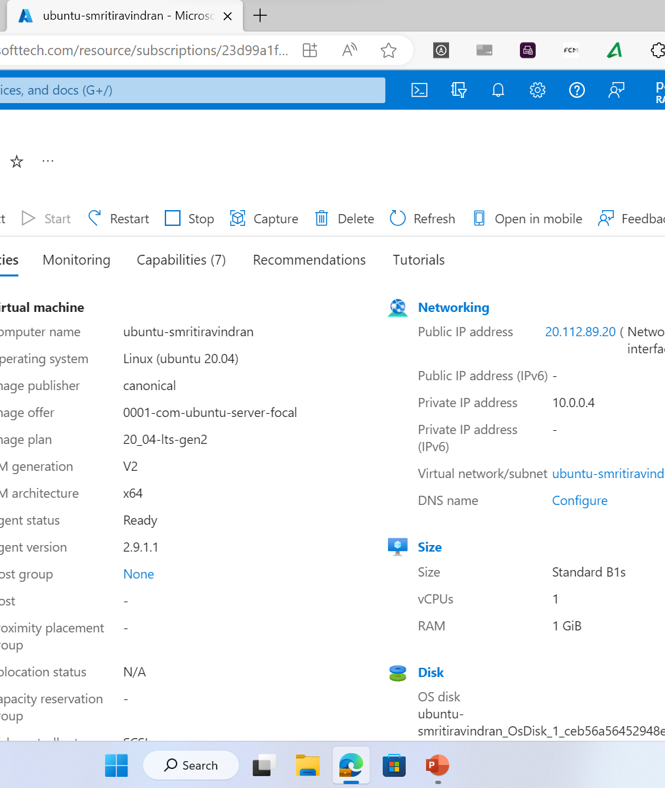
Microsoft Azure (Practical implementation)
Learnt basics of deployment using Microsoft Azure.
Gained insights on Resource groups, monitoring and storage accounts.

Slide 8
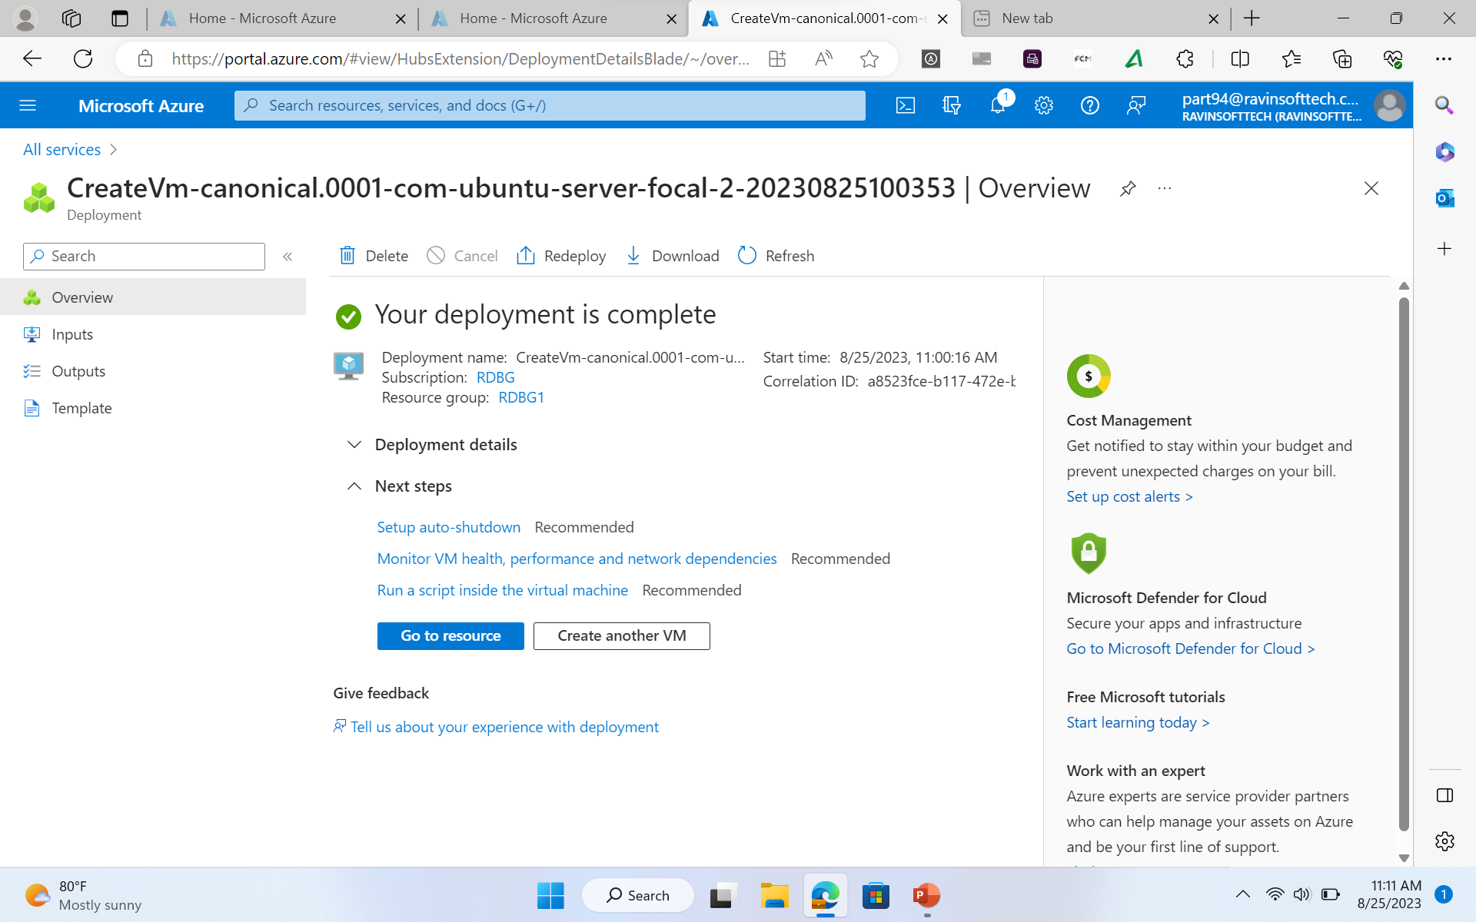

Slide 9
Cloud computing
Cloud Computing is a pretty useful concept to connect, store data, build, deploy and do much more virtually.
Acquired information on Iaas (Information as a service), Paas (Platform as a service) and Saas (Software as a service).
Built a Virtual machine using Microsoft Azure cloud services and understood the various configurations that could be used.
Applied customized disk storage and network settings based on the given requirements.

